Slide 1
Data Structures Workshop
Day 20

Slide 2
Workshop Outline
Stack and Queue Example Problems
Last Minute Exam 2 Questions

Slide 3
Exam 2 Point Distribution
Stacks → 28 pts
Queues → 27 pts
Hashing → 14 pts
Sorting → 14 pts
Heaps → 8 pts
Recursion → 9 pts

Slide 4
Queue Practice

Slide 5
Reverse a Queue
Reverse the elements in a queue recursively.
HINT:
First try using iterative approach using a stack
Then try using recursive approach just using a queue

Slide 6
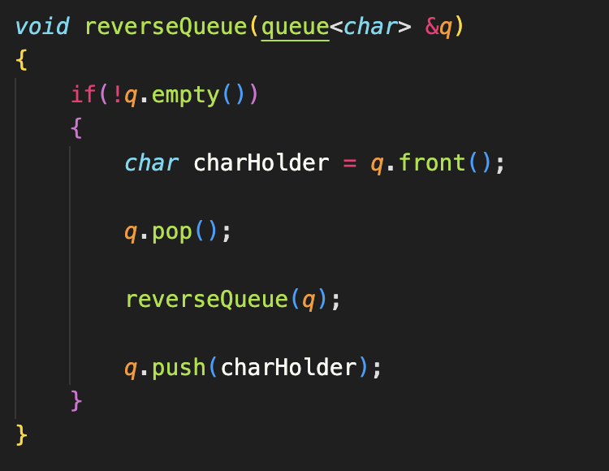
Code Implementation

Slide 7
Count Number of Even Values
Complete the following function, which returns the number of even values that are in a queue.
int countEven(queue<int> &q)
Note: You cannot use any additional data structures. Elements in the queue should as well be in the same order as when passed through the function after the function is done running.

Slide 8
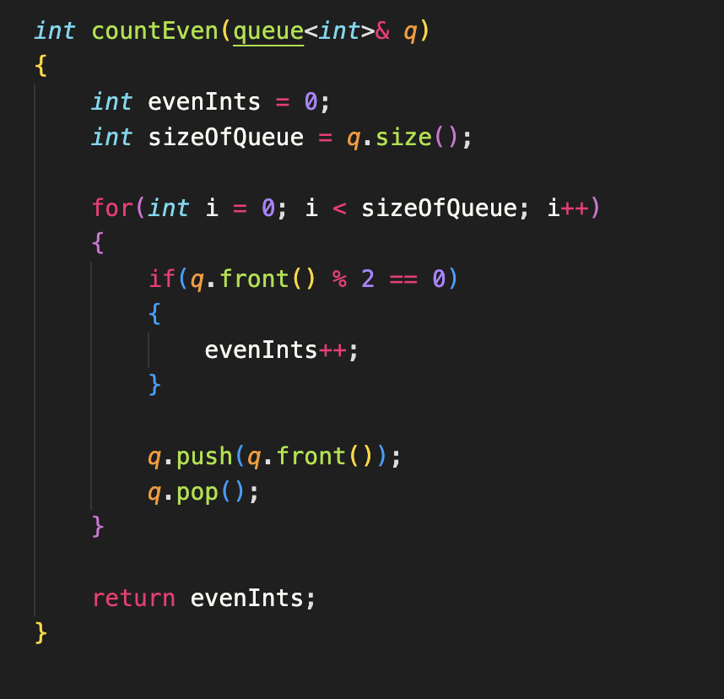
Code
Implementation

Slide 9
Queue Re-Arrangement
Implement a function rearrangeQueue(queue<int> q) that rearranges the given queue of integers. The rearrangement should place the even numbers at the front of the queue and the odd numbers at the back. The relative order of even and odd numbers should be maintained. You can use the following queue functions: push(), pop(), front(), size(), and empty(). You can use 2 single queue. You cannot use any additional data structures or recursion.
For example, if the input queue is {1, 2, 3, 4, 5, 6}, the function should rearrange it to {2, 4, 6, 1, 3, 5} with even numbers at the front and odd numbers at the back.

Slide 10
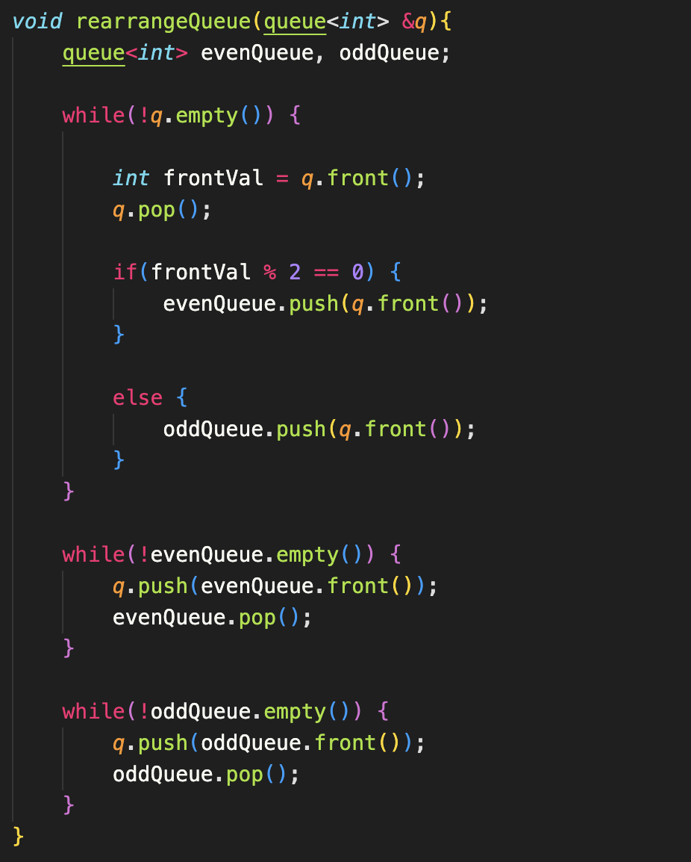
Code
Implementation

Slide 11
Stack Practice

Slide 12
Find Index of Given Value in Stack
Given a value, return the index of where it is in the stack (assume the top of the stack is index 0, and the bottom of the stack is index n - 1, n being the size of the stack). If the value doesn’t exist in the stack, return -1.
Note: You only have access to the C++ stack functions. You cannot use a pointer to traverse the stack.
Challenge: Do this recursively

Slide 13
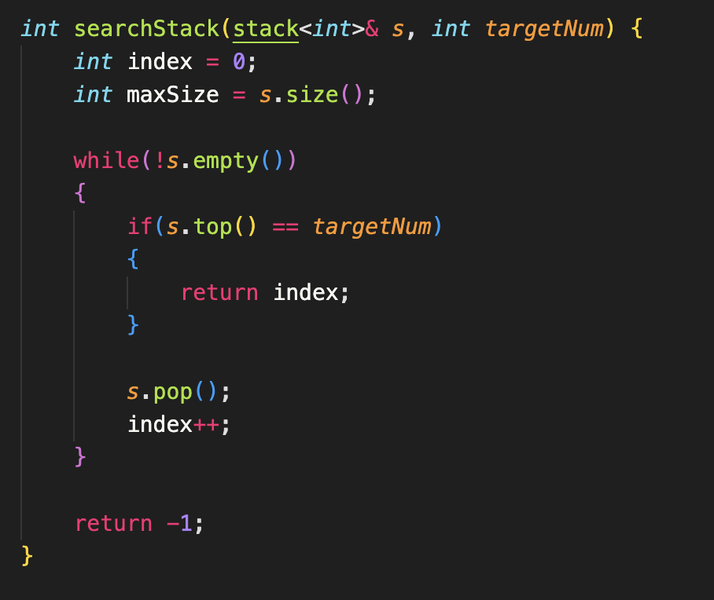
Code
Implementation

Slide 14
Last Minute Questions?
Ask for help/clarification on anything that can be on Exam 2!

